Slide 1





SMOKE DETECTION
MOSTAFA TAREK
MOHAMED
EZZ AL-REGAL
ABD EL-RAHMAN AHMED

Slide 2

Abstract
This research extensively explores various machine learning models for Smoke Detection, evaluating their strengths and weaknesses. It also examines how different feature selection techniques impact model performance. By comparing these methods on benchmark datasets, the study aims to guide the selection of optimal models and features for effective smoke detection. Overall, it provides valuable insights for practitioners and researchers in this field.
PYTHON

Slide 3
Introduction
Our objective is to deeply explore machine learning models for Smoke Detection and their performance with various feature selection techniques. Motivated by the urgency of timely smoke detection for safety, it covers established algorithms like SVM, XGB, Logistic Regression, KNN, NN, Decision Trees, and Random Forests. It emphasizes how feature quality impacts system effectiveness and uses techniques like variance thresholding, correlation analysis, feed-forward, and k-best selection. The structure details the experimental setup, datasets, and evaluation metrics, aiming to aid practitioners in system development. Overall, it contributes to both machine learning knowledge and critical improvements in smoke detection, offering insights applicable to diverse classification tasks.

Slide 4
Data Exploration
01
02
reading the CSV file
Rename the column's name
03
04
Check for Nulls.
Check for Duplicates.

Slide 5
Feature Selection
01
02
03
04
Variance Thresholding
Correlation Analysis
Feed-Forward Selection
k-Best Selection
05
06
07
08
Mutual Information Classification
Mean Absolute Difference
Model Fit Selection for XGBoost
Model Fit Selection for Random Forest
09
Model Fit Selection for Logistic Regression

Slide 6
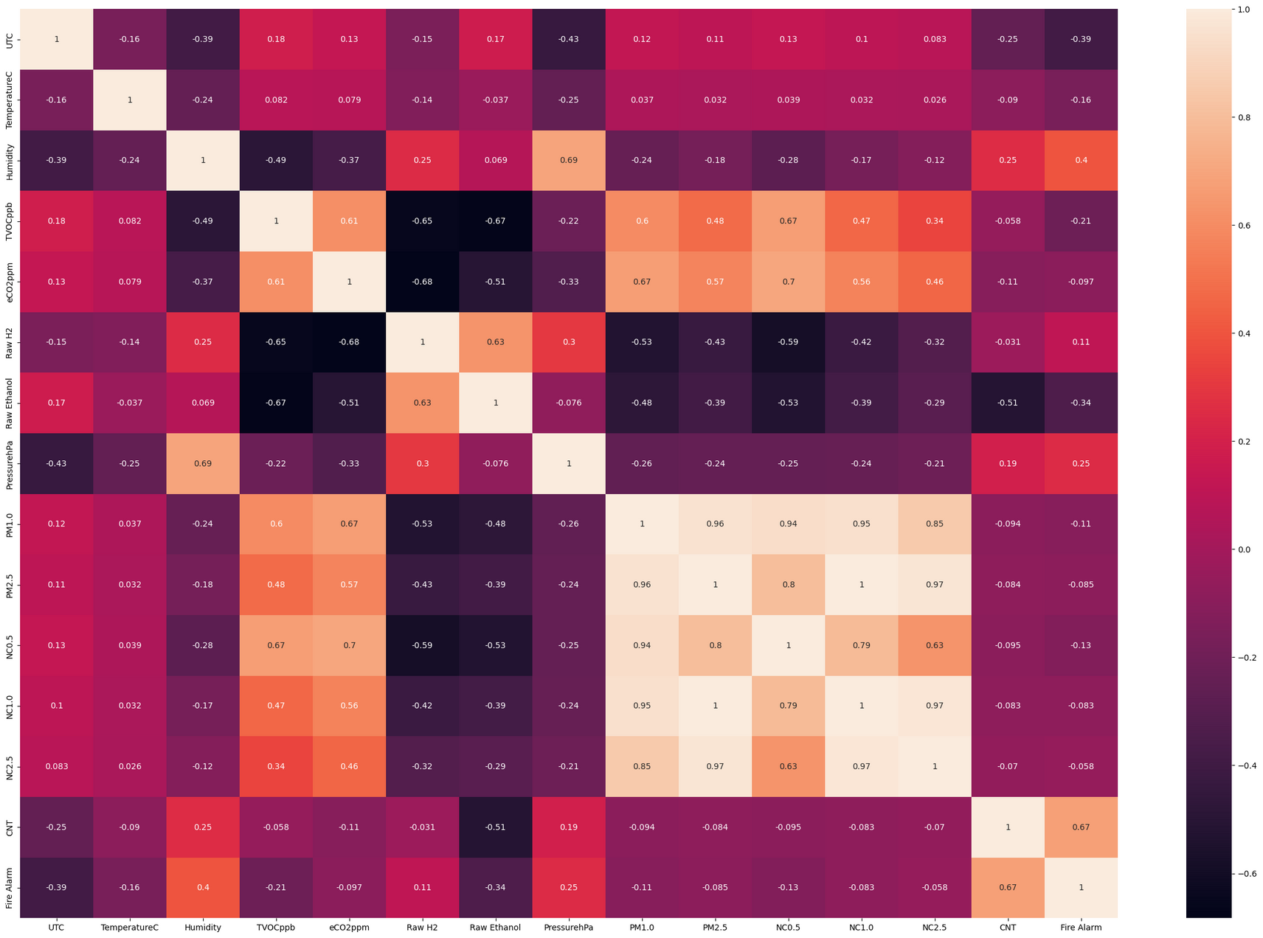
Correlation Map

Slide 7
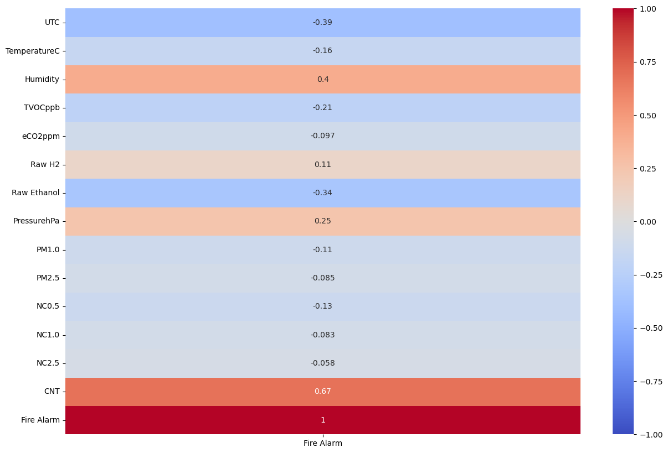
Correlation Map for target feature

Slide 8
Model Used
1. Random Forest
2. Logistic Regression: loss dice coef loss
3. SVM (Support Vector Machine)
4. Naive Bayes
5. K-Nearest Neighbors (KNN):
6. Decision Tree:
7. AdaBoost:
8. Neural Network (Sigmoid):
9. XGBoost:

Slide 9
Metrics
01
02
Accuracy
Precision
03
04
Recall
F1 Score

Slide 10

road map of building model
01
02
03
Load data
Data Preprocessing
Data Visualization
04
05
06
Feature Extraction
Split data into training and testing sets
build model Architecture
07
08
Train Modle
Evaluate the model with test data

Slide 11
Train with all features | Train with all features | Train with all features | Train with all features | Train with all features
 | Accuracy | Precision | Recall | F1 Score
Logistic Regression | 0.715 | 0.715 | 1 | 0.8338
Random Forest | 1 | 1 | 1 | 1
SVM | 0.715 | 0.715 | 1 | 0.8338
Naive Bayes | 0.8263 | 0.8171 | 0.9754 | 0.8892
KNN | 0.9997 | 0.9997 | 0.9999 | 0.9998
Decision Tree | 1 | 1 | 1 | 1
AdaBoost | 1 | 1 | 1 | 1
Neural Network Sigmoid | 0.715 | 0.715 | 1 | 0.8338
XGBoost | 1 | 1 | 1 | 1

Slide 12
Test with all features | Test with all features | Test with all features | Test with all features | Test with all features
 | Accuracy | Precision | Recall | F1 Score
Logistic Regression | 0.7131 | 0.7131 | 1 | 0.8325
Random Forest | 1 | 1 | 1 | 1
SVM | 0.7131 | 0.7131 | 1 | 0.8325
Naive Bayes | 0.8268 | 0.8184 | 0.973 | 0.8891
KNN | 0.9998 | 0.9999 | 0.9999 | 0.9999
Decision Tree | 0.9998 | 0.9998 | 1 | 0.9999
AdaBoost | 0.9999 | 0.9999 | 1 | 0.9999
Neural Network Sigmoid | 0.7131 | 0.7131 | 1 | 0.8325
XGBoost | 1 | 1 | 1 | 1

Slide 13
Train with 5 Features using K Selection | Train with 5 Features using K Selection | Train with 5 Features using K Selection | Train with 5 Features using K Selection | Train with 5 Features using K Selection
 | Accuracy | Precision | Recall | F1 Score
Logistic Regression | 0.9817 | 0.9972 | 0.9771 | 0.9871
Random Forest | 1 | 1 | 1 | 1
SVM | 0.9813 | 0.9946 | 0.9791 | 0.9868
Naive Bayes | 0.8799 | 0.8708 | 0.977 | 0.9208
KNN | 0.9997 | 0.9996 | 1 | 0.9998
Decision Tree | 0.9999 | 0.9999 | 1 | 0.9999
AdaBoost | 0.9956 | 0.9967 | 0.9972 | 0.9969
Neural Network Sigmoid | 0.9865 | 0.9925 | 0.9886 | 0.9906
XGBoost | 1 | 1 | 1 | 1

Slide 14
Test with 5 Features using K Selection | Test with 5 Features using K Selection | Test with 5 Features using K Selection | Test with 5 Features using K Selection | Test with 5 Features using K Selection
 | Accuracy | Precision | Recall | F1 Score
Logistic Regression | 0.981 | 0.9973 | 0.976 | 0.9865
Random Forest | 0.9999 | 1 | 0.9999 | 0.9999
SVM | 0.9796 | 0.9948 | 0.9765 | 0.9855
Naive Bayes | 0.8814 | 0.8731 | 0.9755 | 0.9215
KNN | 0.9996 | 0.9994 | 1 | 0.9997
Decision Tree | 1 | 1 | 1 | 1
AdaBoost | 0.9954 | 0.9962 | 0.9973 | 0.9968
Neural Network Sigmoid | 0.987 | 0.9929 | 0.9888 | 0.9909
XGBoost | 1 | 1 | 1 | 1

Slide 15
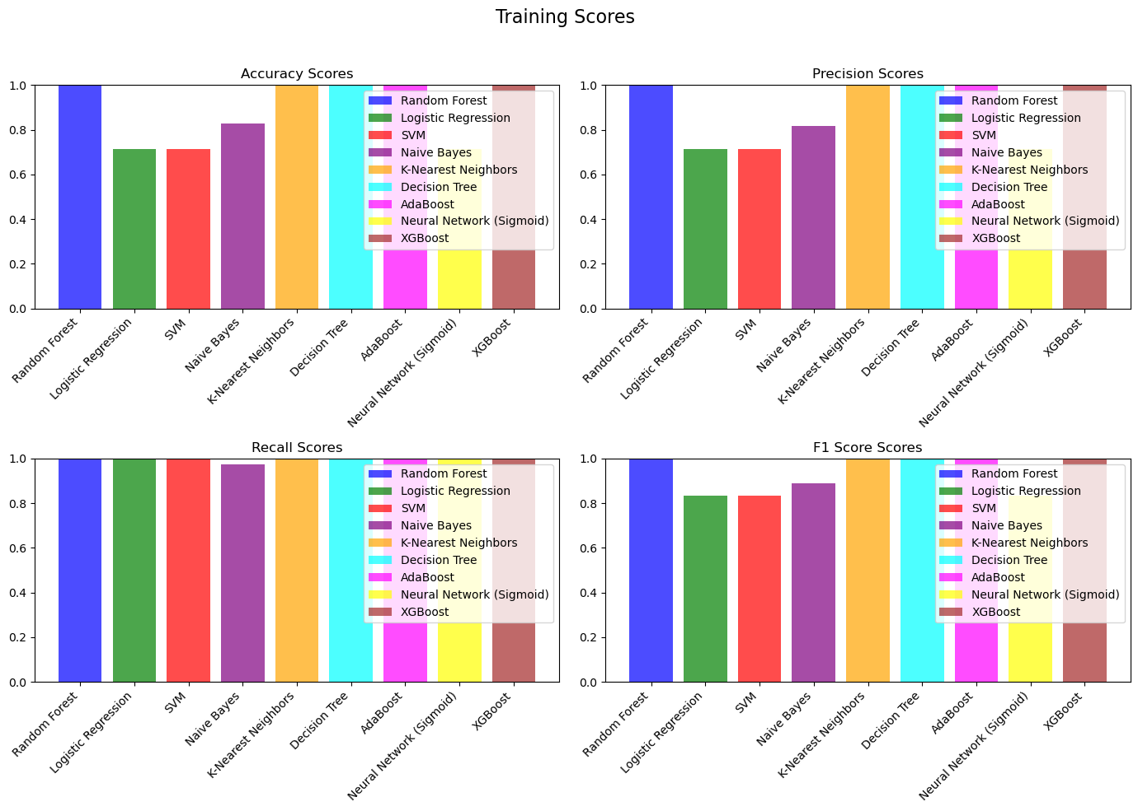

Slide 16


Slide 17
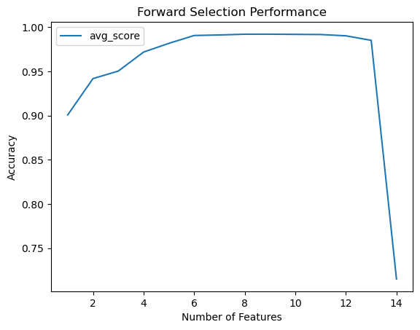
Why do we stop at K = 5?

Slide 18
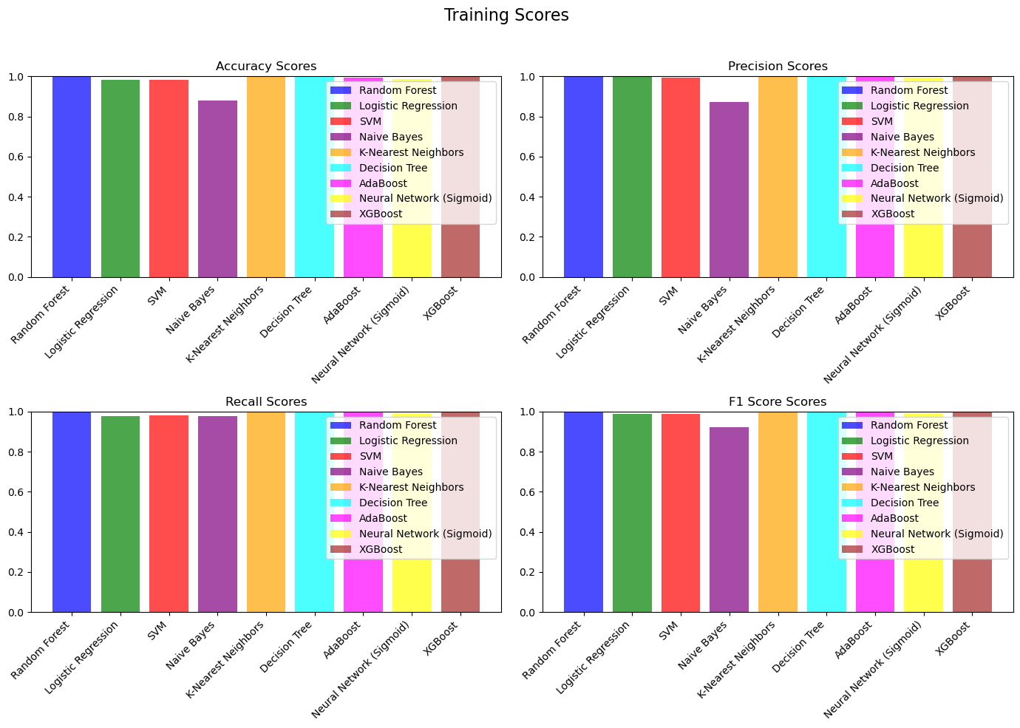

Slide 19


Slide 20
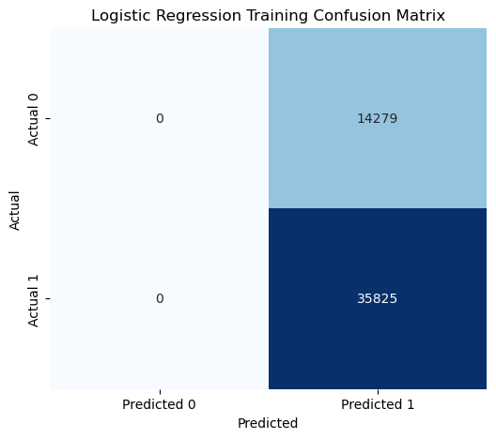

Confusion matrix for all features

Slide 21
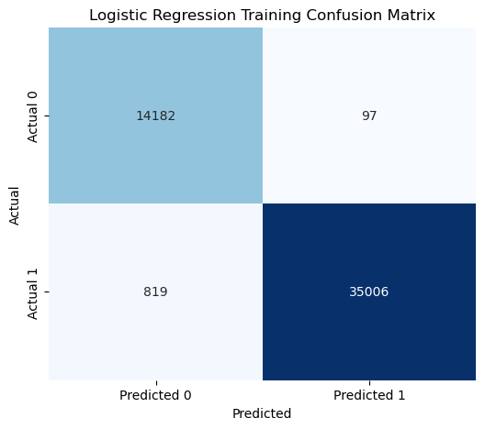
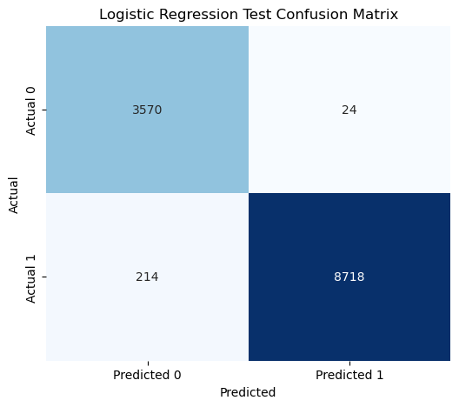
Confusion matrix for best 5 features

